Slide 1


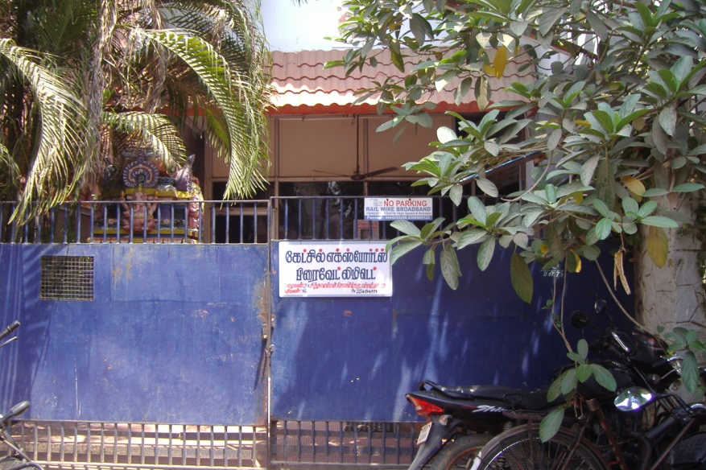
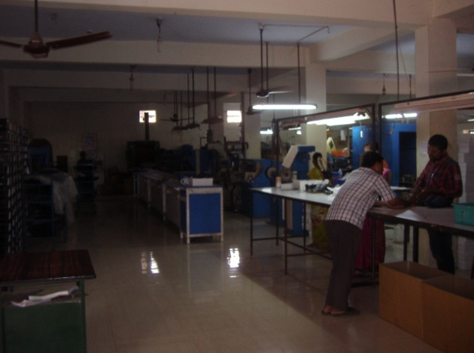
INDUSTRIAL LAND AND BUILDING
INDS - 001
Location of Property | PAMMAL
Total area of flat | 5709 sq.ft
Constructed area | Ground floor &First floor – 8259 sq.ft
Year of construction | 1997
Current market value | Rs. 184.50 lacs

Slide 2
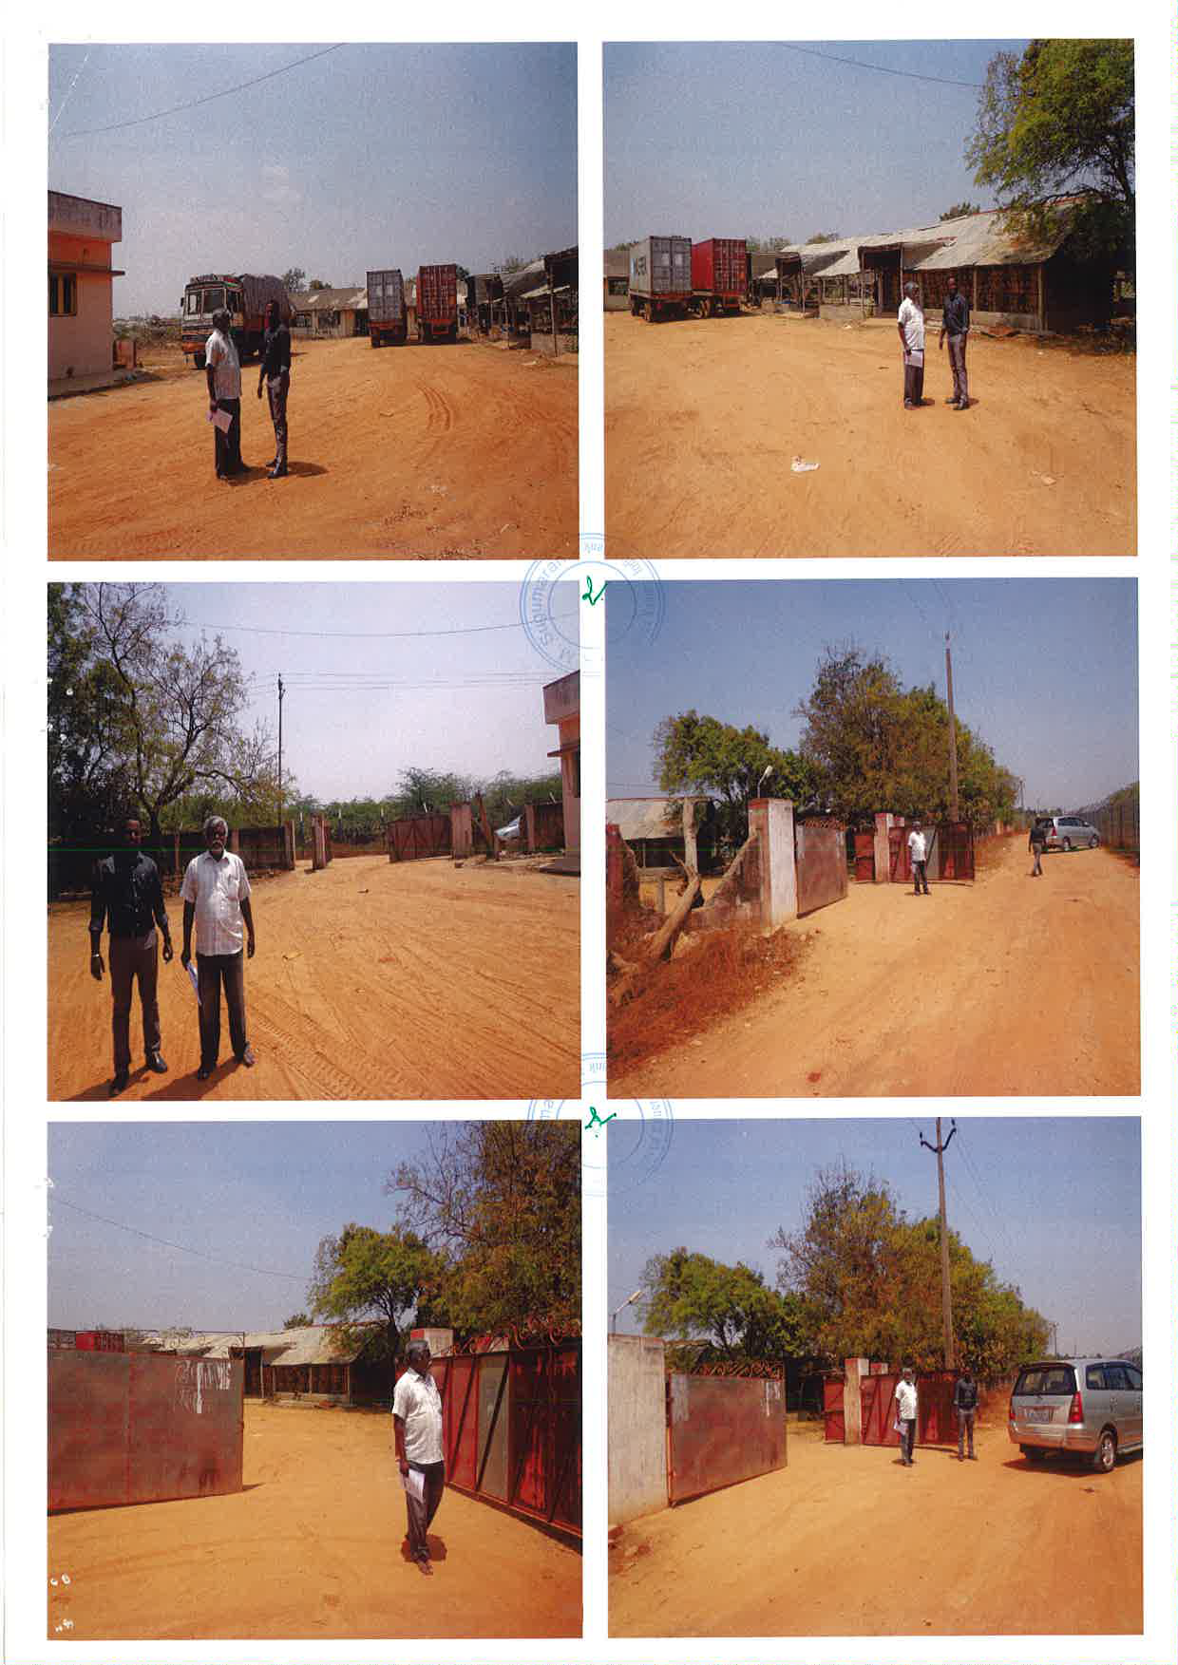
INDUSTRIAL LAND & BUILDING
INDS - 002
Location of Property | REDHILLS, CHENNAI
Total area of land | 80.50 CENTS
Constructed area
Year of construction | 2000
Current market value | Rs. 125.43 lacs

Slide 3
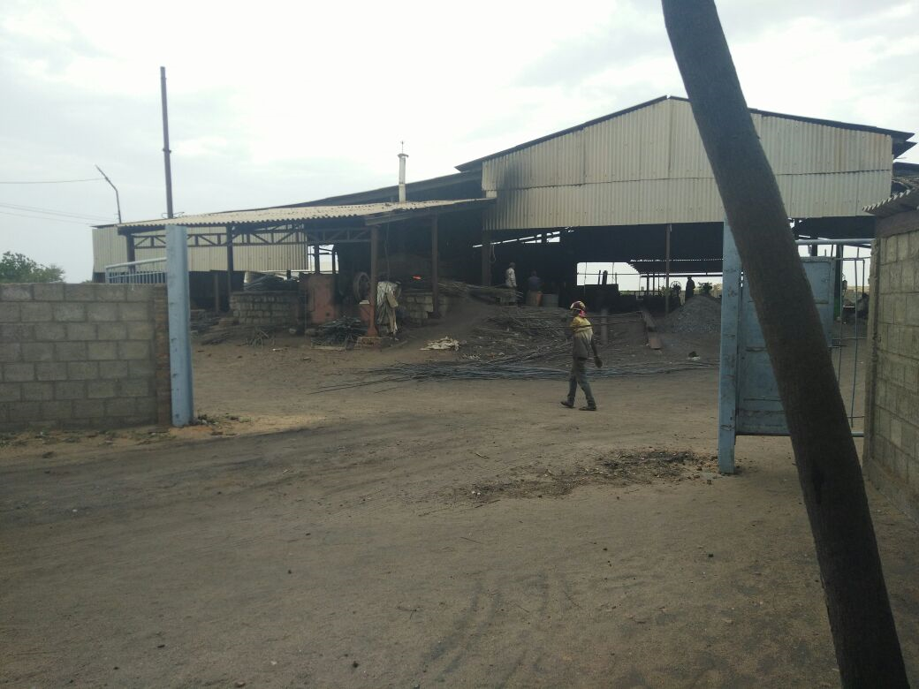
INDUSTRIAL LAND & BUILDING
COMMERCIAL LAND
INDS - 003
Location of Property | SRIRANGAM,TRICHY
Total area of land | 2.00 Acres
Constructed area | 10415 sq.ft
Year of construction | 2010
Current market value | Rs. 104.00 lacs

Slide 4
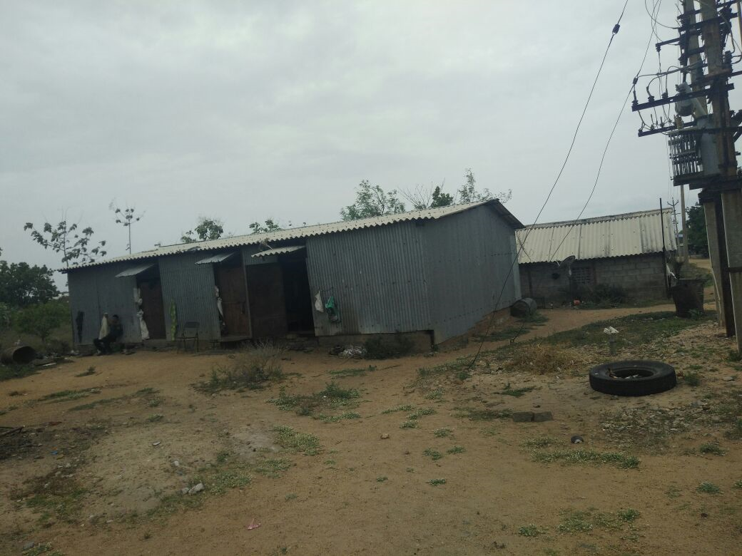
INDUSTRIAL LAND & BUILDING
INDS - 004
Location of Property | SRIRANGAM,TRICHY
Total area of land | 2.66 Acres
Constructed area | 4125 sq.ft
Year of construction | 2010
Current market value | Rs. 79.15 lacs

Slide 5
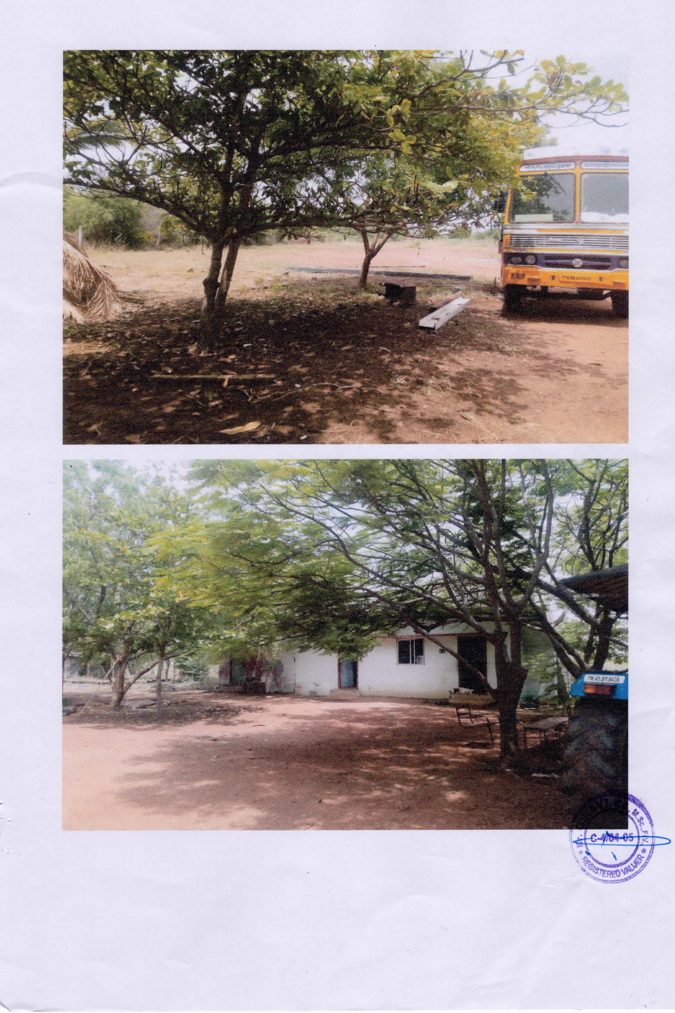
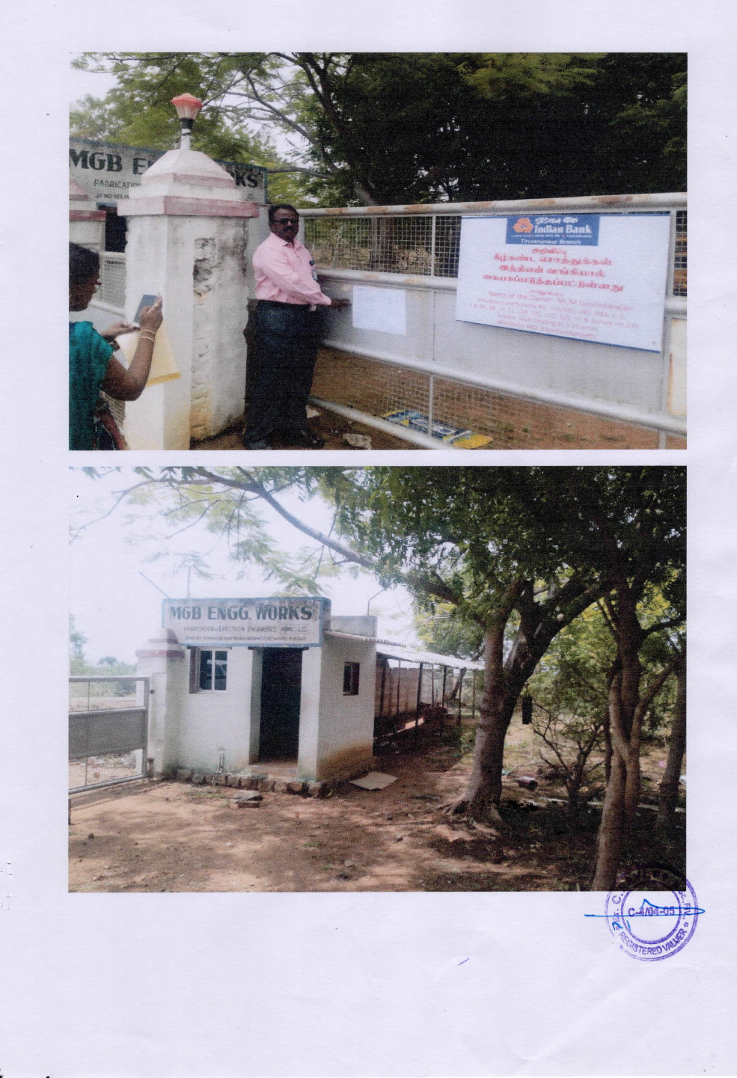
INDUSTRIAL LAND & BUILDING
INDS - 005
Location of Property | TANJORE
Total area of land | 3.16 Acres
Constructed area | 897sq.ft
Year of construction | 2008
Current market value | Rs. 70.00 lacs

Slide 6
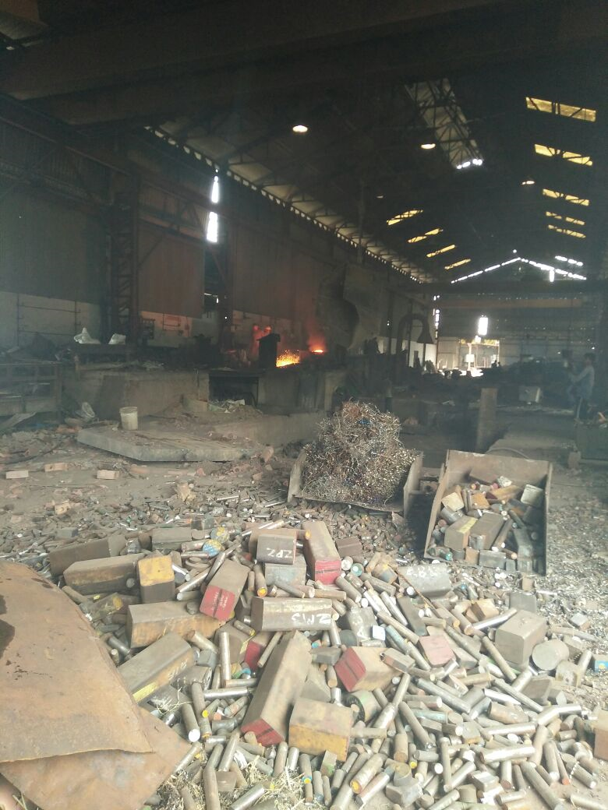
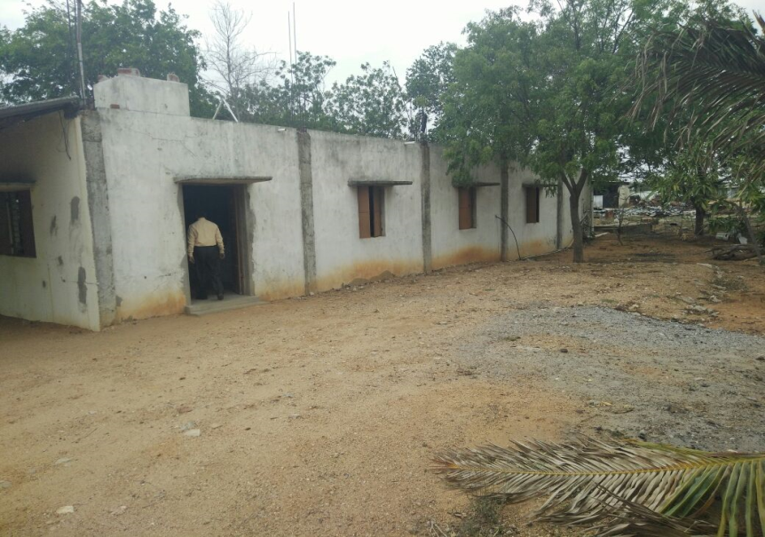
INDUSTRIAL LAND & BUILDING
INDS - 006
Location of Property | SRIRANGAM,TRICHY
Total area of land | 5.04 Acres
Constructed area | 30218 sq.ft
Year of construction | 2010
Current market value | Rs. 485.30 lacs

Slide 7

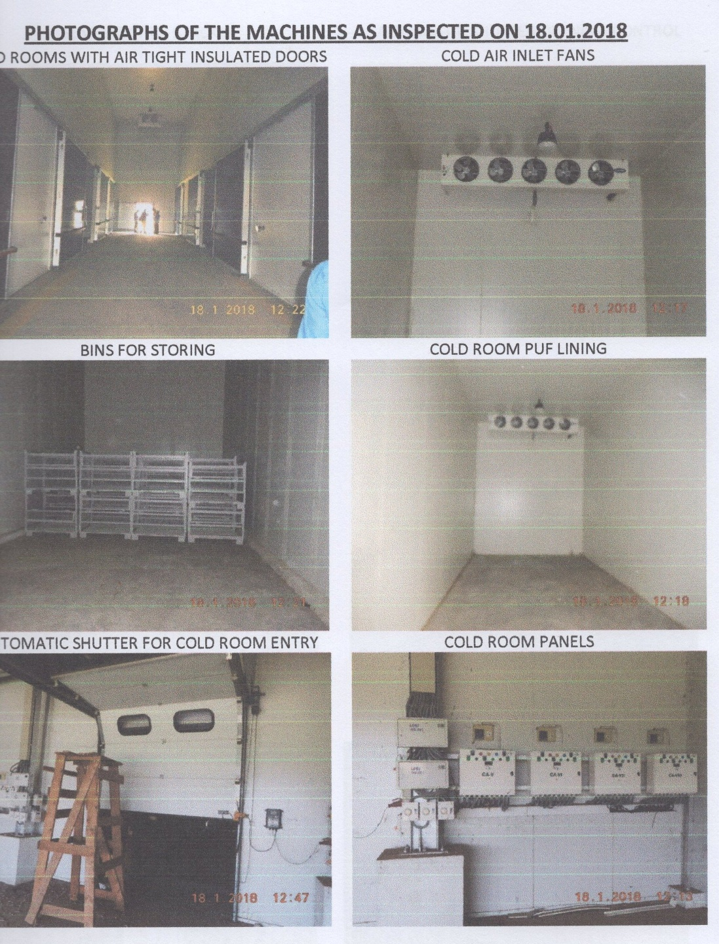
INDUSTRIAL LAND & BUILDING
INDS - 007
Borrower Name | M/s Frozen Fruits & Vegetables
Location of Property | Mettupalayam, Coimbatore Dist
Year of Purchase | 2013
Constructed area | Onion & Potato Cold Storage Unit -
Current market value | Rs. 267.00 lakhs
Sale value | Rs. 172.00 lakhs

Slide 8
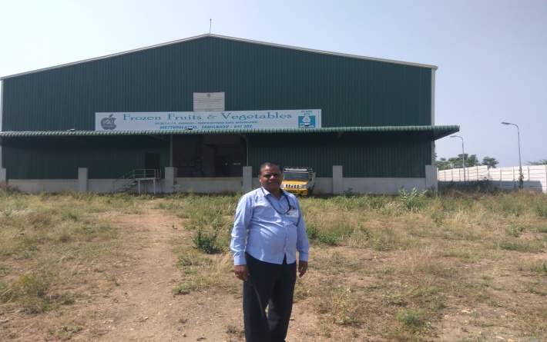
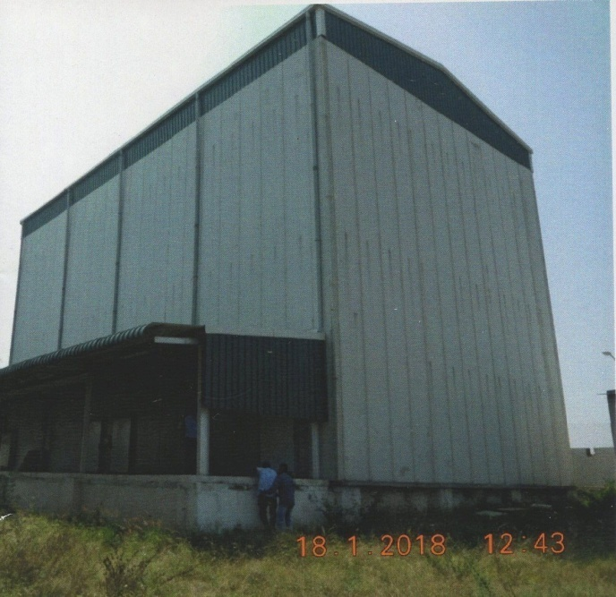
INDUSTRIAL LAND & BUILDING
INDS - 008
Borrower Name | M/s Frozen Fruits & Vegetables
Location of Property | Mettupalayam, Coimbatore Dist
Total area of land | 1.24 Acres
Constructed area | Cold Storage Unit
Current market value | Rs. 215.00 lakhs
Sale value | Rs. 172.00 lakhs

Slide 9

INDUSTRIAL LAND & BUILDING
INDS- 009
Location of Property | Mr Mahaboobjohn MaduraiMain Palamedu, Madurai Dist
Total area of land | 2178.38 Sq. Ft
Constructed area | 1998 Sq Ft.
Year of construction | 2013
Current market value | Rs. 21.61 Lakhs
Sale value | Rs. 19.45 Lakhs

